Slide 1
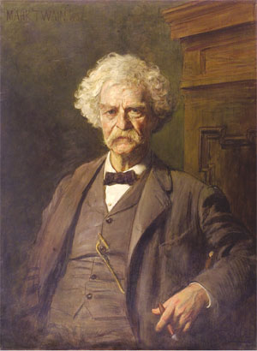
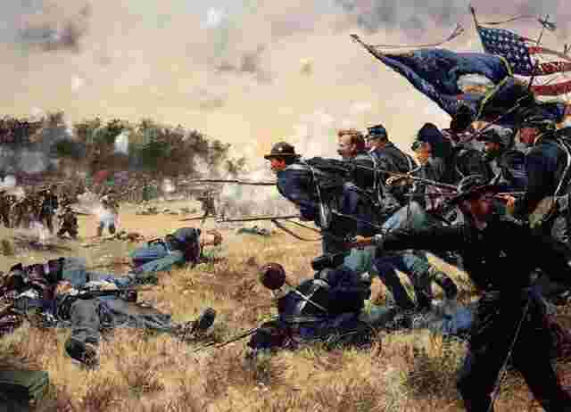
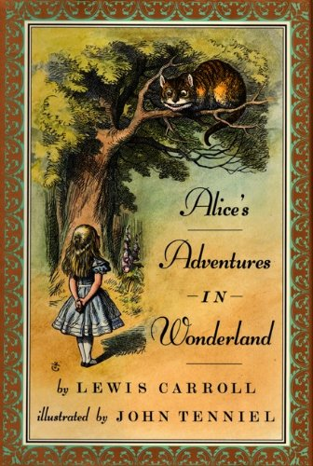
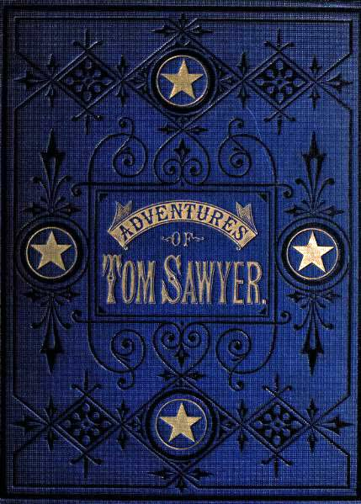
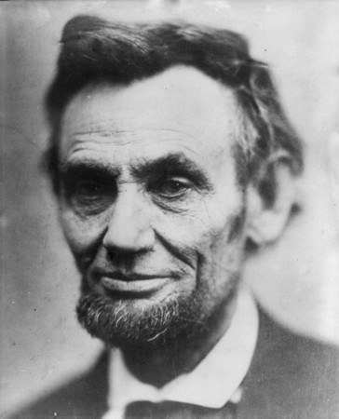
1850-1914
Presented by:
Team Shpoopel

Slide 2
America breaks in two
1804 all states north of the Mason-Dixon line pass laws to abolish slavery.
1860 Abraham Lincoln is elected president of the U.S.
On December 24th, 1860 South Carolina becomes the first state to succeed from the Union.
By February of 1861 seven states in the deep south seceded from the Union
On February 4th 1861 the southern slave states establish the Confederate States of America and elect Jefferson Davis as president.

Slide 3
America goes to war….with itself
Civil war began in 1861
Emancipation Proclamation was a issued on January 1st 1863, freeing 3.1 million of the 4 million slaves in America at the time.
The civil war ends with a victory for the Union in 1865
The thirteenth amendment completely abolishes slavery in 1865

Slide 4
A unique time of innovation
Charles Darwin publishes On The Origin of Species and causes controversy with his theory of evolution.
After the Spanish American war of 1898 and the assassination of president McKinley Theodore Roosevelt becomes president and works to make America a world power.
In 1905 Albert Einstein publishes his theory of relativity.

Slide 5
Major Literary Movements
Authors started wring about real life situations to relate to the readers
Local color writing is an attempt to illustrate specific language and prospective.
Authors wrote about what was going on in America

Slide 6
Predominate Themes
Adventure books like “The Adventures of Huckleberry Fin” and “ The Adventures of Tom Sawyer”
Writings about peoples lives and what they did in them like “Call of the Wild”
Freedom

Slide 7
Prominent Writers and Their Books
Walt Whitman – Leaves Of Grass 1855
Mark Twain – Adventures Of Tom Sawyer 1876, Adventures Of Huckleberry Finn 1884
Stephen Crane – The Red Badge Of Courage 1895
Jack London – Call To The Wild 1903

Slide 8
How They Reflected On Their Times
Leaves Of Grass By Walt Whitman is a book of poems. His poems were different from the ones at the time because he broke the traditional rules of rhythm and rhyme. This book explored this style and reflected on this time by showing there wasn’t many styles of writing.
Mark Twain wrote two books that are still read today. One of the reasons they are still being read is because, he did not write in old English. He took everyday speech of characters and put it straight in his books. They were written entirely in “American”.

Slide 9
Continued…
Stephen Crane wrote The Red Badge Of Courage in 1895. This novel is about the Civil War. It is unique because Stephen was born after the war. Yet it is one of the most descriptive novels on the Civil War. Stephen explores the young soldiers mental state and reactions to and during war.
Call To The Wild was published by Jack London in 1903. Jack had an extremely hard life he grew up in poverty and supported himself with jobs like a paperboy and working on and ice wagon. Most of Jacks books are about the struggle between man and the wilderness.

Slide 10
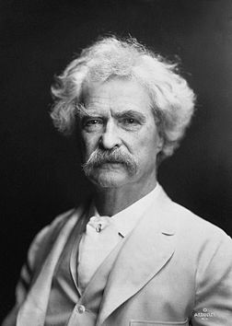
Prominent Authors of the Time
Fredrick Douglas
Gustave Flaubert
Jack London
Leo Tolstoy
Mark Twain ^
Mark Twain

Slide 11
Importance of Writing
Fredrick Douglas
My Bandage My Freedom
Auto- biography , slavery
Gustave Flaubert
Madame Bovery
Realism
Jack London
Man-kinds endurance
In the face of challenging natural forces

Slide 12
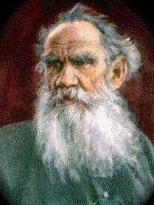
Importance of Writing con’t…
Leo Tolstoy
Fiction and realism
Mark Twain
Cultural and current events
Leo Tolstoy ^

Slide 13
Continued…
In Jacks books he reflects on his time by dealing with wilderness. During this time they were conquering wilderness by learning how to fly, building railroads, building the automobile, and growing as a nation.

Slide 14
International figures of this area
Abraham Lincoln
Thomas Edison patens phonograph 1884
Karl Benz builds the first internal combustion engine car
the Industrial revolution
railroads were taking native land

Slide 15
Major events of the time period
Civil war declared in 1861
Charles dickens tale of 2 cites 1859
Colorado became a state 1876
Brooklyn bride is open 1883

Slide 16
Works cited
http://www.wwnorton.com/college/english/naal7/contents/C/welcome.asp#2
Textbook
Wikipedia

