Slide 1

1750-1800
Alexis, Brandon, German, Jake, Tyler

Slide 2

1752- Ben Franklin, lightning experiment
1759-1763-France Gives Up Northern Territory
1769- Scotland invents steam engine
Unique About Time Period

Slide 3
Unique About Time Period
1765- Colonists protest
about Stamp Act
1793- Eli Whitney Invents
cotton Gin

Slide 4
What Were Some of the Major Political, Social, Economic, and Cultural Events and/or Trends of this Time Period?
Political Events –
  America was becoming a nation
  Napoleon came into power of France
Social Events –
  Boston Tea Party
  First and Second Continental Congress

Slide 5
Economic Events –
  British taxed colonists harshly
  France gives up North American territories
Cultural Events –
  1790 – 757,208 blacks in U.S.
  Only 59,557 were free

Slide 6
International Prominent Figures
Ludwig Von Beethoven
William Herschel
Wrote music for entertainment
Composed first symphony
Discovered planet Uranus

Slide 7
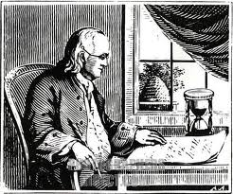
Prominent American Figures
Benjamin Franklin
Journalist-wrote for almanac
Became a scientist

Slide 8
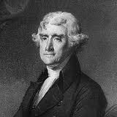
Prominent American Figures
Thomas Jefferson
Wrote Declaration of Independence.
Wrote Bills for Congress

Slide 9
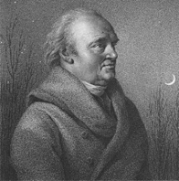
Prominent International Figures
William Herschel
Discovered Planet Uranus
Also discovered many double stars
First to describe spiral structure of Milky Way

Slide 10
Major U.S. Achievements
1755- Samuel Johnson publishes dictionary.
1776- Congress adopts Declaration of Independence.
1783- Revolutionary War ended.

Slide 11
Major U.S. Achievements
1781- British surrender to Washington at Yorktown
1789- George Washington was elected.
He became the first president.

Slide 12
What Types of Writing i.e. Genres were Predominant During this Time Period? Why?
Government Document –
  The United States Constitution
  Declaration of Independence
Poems/Hymns
  An Hymn to the Evening
  Beethoven composes First Symphony

Slide 13
What major literary movements developed during this time period?
1775- First dictionary published, Samuel J.
1769- Published first dictionary, James B.
Near War of Independence, 30 newspapers established
1773- Phillis Wheatley’s poems on various subjects published in English.

Slide 14
Predominate themes of writing at the time
The Revolutionary era was known as the era of reason
The biggest topic of writing was politics
Writers talked American pride and patriotism
Writers tried agree on issues

Slide 15
Types of political writing
Political pamphlets creates patriotism
Travel writing promotes pride
Highly ornate style helps people agree
Persuasive writing what America is about

