Slide 1
A Growing Nation
1800-1870

Slide 2
Unique about the 1800-1870
First Industrial Revolution
Better Agriculture
Population growth
Sanitation speed up
War of 1812
Notes:
Coal, railroads, and land clearing speed up greenhouse, gas emission.
American leader declared war on great Britain, believed that they were beginning a second war of independence

Slide 3
Major political, social, economic, and cultural events
Star spangle banner 1814
1848- new territory
Female and male literacy rates 1850
California Gold Rush-1848
Notes:
Was written
Transportation improved, the U.S stretched from the Atlantic ocean to the pacific ocean
Female- 55%, male-70%
The California Gold Rush begins

Slide 4
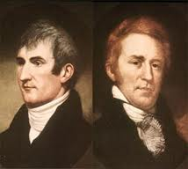
Lewis & Clark Expedition
Meriwether Lewis and William Clark were sent to explore the Pacific Coast by President Lincoln in 1804.
Their objectives were to study the area’s plants, animal life, and how the region could be exploited economically.
One goal was to find a direct & practicable water communication across this continent, for the purposes of commerce with Asia.
Notes:
Lewis and Clark were helped by a fifteen year old Shoshone Indian woman named Sacagawea. She was the wife of a French fur trader. Reports about geography, plant and animal life, and Indian cultures filled their daily journals. Their expedition ended in 1806.

Slide 5
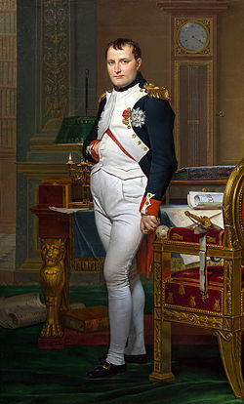
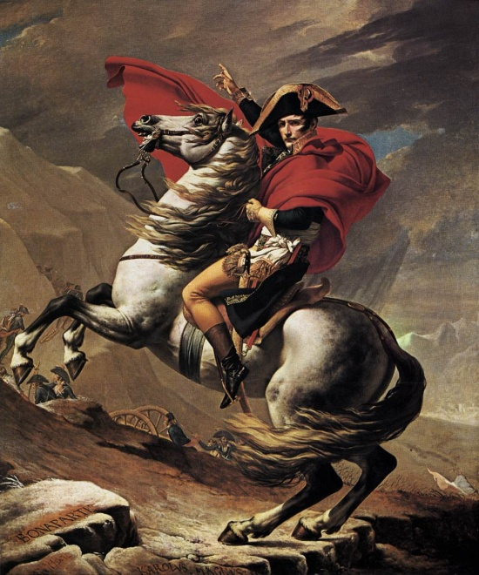
Napoleon Bonaparte
Napoleon was a French military and political leader during the latter stages of the French Revolution.
Best remembered for his role in the wars led against France by a series of coalitions.
His legal reform, the Napoleonic code, has been a major influence on many civil laws jurisdictions worldwide
Notes:
Napoleon was one of the international figures in this time period. Leader in the revolution from 1804-1815.
During these so called Napoleonic wars, he established hegemony(an indirect form of imperial dominance) over most continental Europe and wanted to spread the ideals of the French revolution
The Napoleonic codes forbade privileges based on birth, allowed freedom of religion, and made sure that government jobs go to the most qualified

Slide 6
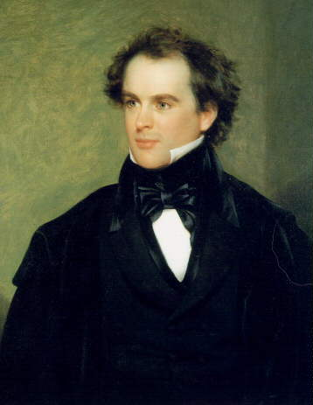
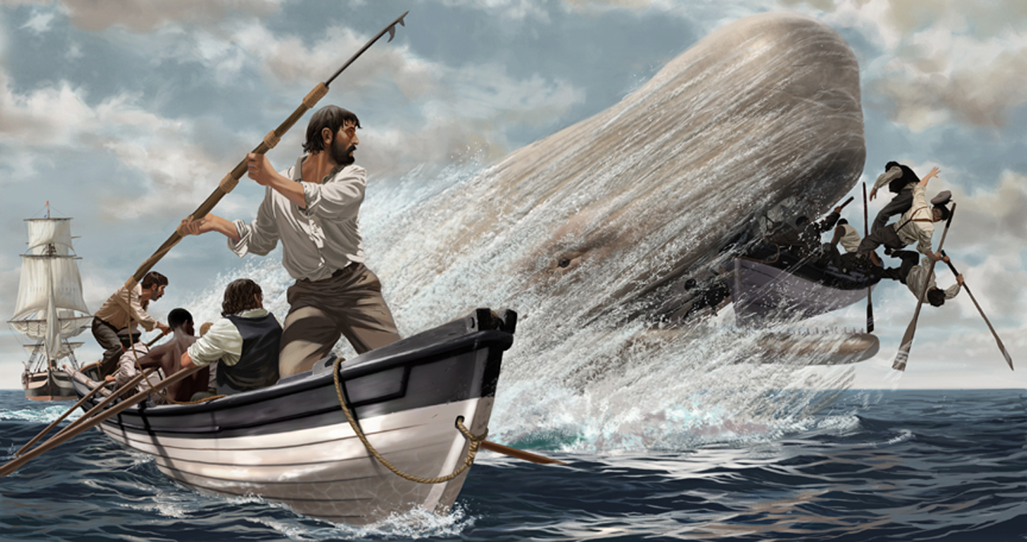
Prominent Writers, And How They Reflected The Times
1880-1887
Nathaniel Hawthorne (Pictured to the left) and Herman Marville were some of the eras most prominent authors, and created such works as Moby Dick. (pictured to the right)
Other prominent authors included Mark Twain, and featured such literary works as : Adventures of Huckleberry Finn

Slide 7
Popular Genres
Popular genres included anti-slavery and nature.
Other genres included fiction, and Autobiographies.

Slide 8
1880-1887
Some of the movements that were going around were war of 1812 that had brought out star spangle banner some of the writer like Edgar Allen Poe, and Nathaniel Hawthorne
movements of the 1880’s were the new England's Literary Renaissance.
Notes:
Name the authors that were that were around

Slide 9
Themes of writing in 1880’s
Some of the themes that had come around in the 1887 were the dreams of going west, literature of the Civil War, and myths and legends came around such as the legends of Atlantis.
Another types of theme is the arts and cultures of other countries such as Columbia

