Slide 1
Modern Literature
1946-Present
Kayla Gobin, Micaela Lowe,
Michaela Medrano, Cassidy Thompson, & Reh Vanatta

Slide 2
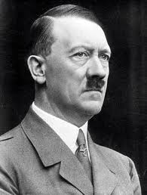
Important and prominent international figures
Adolf Hitler (1945)
- Leader of Nazi party and German dictator
Albert John Luthuli (1960)
- Established peace and equality for African Americans
Fidel Castro (1959-67)
- Communist and Anti-capitalist
Mohandas Karamchand Gandhi (1945)
- Major political and spiritual leader
Osama Bin Laden (2001)
- Mastermind of 9/11 attacks

Slide 3
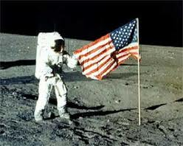
U.s. achievements in history
First Nuclear Power plant Built (1951)
- First Business Computer Built (1951)
- Handle both numeric and alphabetic data.
- Civil Rights Act (1964)
- Established to protect citizens from racism, sexism and other forms of prejudice in school, employment and public areas.
- First Person on Moon (1969)
- Neil Armstrong
- Nixon Goes to China (1972)
- Ends hostility between countries.

Slide 4
U.S. Achievements in history Continued
- NAFTA signed and approved (1992-3)
- Proposed to eliminate restrictions on the flow of goods, services, and investment in North America.
- Welfare Reform Passed (1996)
- War is Declared (2001)
- Liberating 27 million people from Taliban oppression.

Slide 5
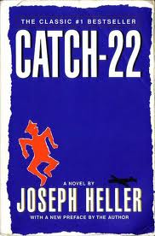
Prominent American Writers
Ralph Ellison: Invisible Man
- Addressed issues concerning African Americans
Flannery O’Conner: A Good Man Is Hard To Find
- Fiction, Religious, Murder
Joseph Heller: Catch- 22
- Plot takes place during World War II

Slide 6
Prominent American Writers continued
Amy Tan: The Hundred Secret Senses
- Shortlisted for the 1996 Orange Prize For Fiction
Toni Morrison: Wins Nobel Peace Prize for Literature
- Wrote The Bluest Eye, Song of Solomon, Beloved, and more.
- Novels were known for her epic themes, great dialogue, and well described characters.

Slide 7
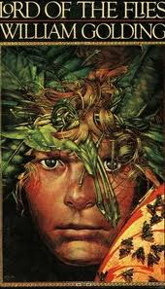
Other prominent writers
Doris Lessing: The Grass Is Singing
- From England
- Describes racial conflict between blacks and whites in Africa
William Golding: Lord of the Flies
- From England
- Controversial topics, depicts a self-governed island
Jorge Luis Borges: Extraordinary Tales
- From Aregentina

Slide 8
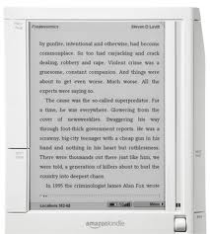
Genres and Technological Influences
Fiction, Poetry, Non-Fiction, etc.
- Pretty much all genres are present
- Both religious and other writing is accepted at the time.
Slam Poetry is introduced.
Electronic/Audio Books become common.
- Ipads, Kindles, Laptops, CD Books, etc.

Slide 9

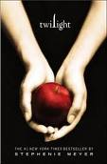
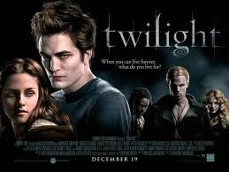
Genres and tehcnological influences continued
Many books are being turned into movies in this time.
Song Lyrics
- Poetry is being expressed in song form (Rap especially)
Newspapers and Magazines
Literature on the Internet

Slide 10
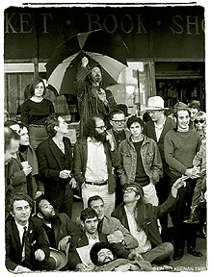
Literary Movements
After president Kennedy’s assassination, many movements arose because of the cultural revolution.

Slide 11
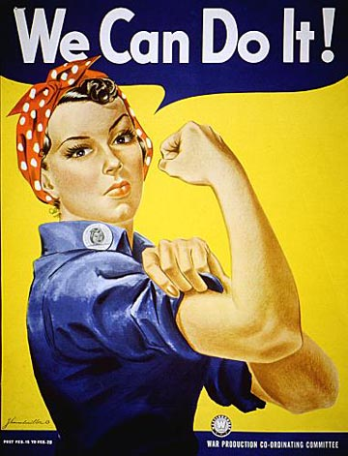

Feminist Movement: Express cultural political interests; equality.
Black Arts Movement: Allowed colored authors to share their stories without feeling like they were speaking for their race.
Native American Literature: Native works could be published.
Notes:
After World War Two, a lot of people liked the calm atmosphere, until Kennedy’s assassination and the Vietnam way, which made people want to speak out about their opinions.
All of these movements were happening around the same time.
All of these movements were a part of the culutural revolution, and all were a way of figuring out a way to describe ourselves.

Slide 12
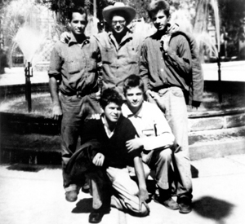
Beat Generation Mid 1950s- early 60s
A group that got together to how America was getting “beaten
down”.
Many group members were homosexual or bisexual and wanted to press the issue of individual freedom.
Published all different kinds of writing to express their opinions.
Notes:
The beat generation dressed how they wanted to, and did what they wanted to, such as drugs and meditation.
They felt as though they were showing people they could show their uniqueness without having to feel guilty about it.

Slide 13
Predominate Themes
1: ethnic idntity: after World war 2 people wrote about race and it wasn't always accepted.
2: fiction/nonfiction
3: autobiographical intensity/ confessional: to break up some conventions of formality and universality

Slide 14
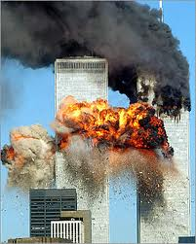
Predominate themes continued
4: tragedy: after 9/11 people wrote more and more about what happened and grew more into writing tragedies.
5: novels love stories: it shows how we grew away from puritan beliefs
6: Literature responded the aesthetic project of modernism

Slide 15
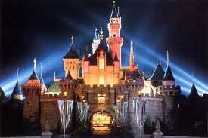
Unique things about this time
Berlin Wall put up in Germany in 1948
Gandhi was assasinated in 1948
China becomes communist in 1949
Disneyland opened in 1955
T.V. remote control was invented in 1956

Slide 16
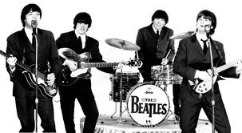
Major Events
Economic Event: Wealth was important and valued during this time
Social Event: Marylyn Monroe was found dead in 1962
Cultural Event: The Beatles became popular in the U.S.
Political Event: John F. Kennedy was assassinated in 1963

Slide 17
bibliographies
Matterson, Stephan. "The American Novel . Literary Timeline . Movements . Beat Generation PBS." PBS: Public Broadcasting Service. 2003. Web. 21 Sept. 2011. http://www.pbs.org/wnet/americannovel/timeline/beatgeneration.html
Repubilcan National Committee. "Accomplishments". GOP. 2011. Republican National Committee (RNC). September 25th, 2011. http://www.gop.com/index.php/issues/accomplishment/.
Infoplease. "Year by Year". infoplease. May, 2011. Pearson Education. September 25th, 2011. http://www.infoplease.com/yearbyyear.html

Slide 18
Bibliographies
"Norton Anthology of American Literature, 7th Edition." Home | W. W. Norton & Company. W.W. Norton & Company, 2007. Web. 21 Sept. 2011. <http://www.wwnorton.com/college/english/naal7/contents/E/welcome.asp>.
Prentice Hall Literature. New Jersey: Upper Saddle River. 2002. Print.
Rosenberg Jennifer.“1940s Timline”. http:/history1900s.about.com/od/timelines/tp/1940timeline.htm

Slide 19
bibliographies
Invisible Man. Wikipedia. Retrieved September 25, 2011, from: http://en.wikipedia.org/wiki/Invisible_Man
A Good Man Is Hard To Find (short story). Wikipedia. Retrieved September 25, 2011, from: http://en.wikipedia.org/wiki/A_Good_Man_Is_Hard_to_Find_(short_story)
Catch- 22. Wikipedia. Retrieved September 25, 2011, from: http://en.wikipedia.org/wiki/Catch-22

Slide 20
Bibliographies
The Hundred Secret Senses. Wikipedia. Retrieved September 25, 2011, from: http://en.wikipedia.org/wiki/The_Hundred_Secret_Senses
Toni Morrison. Wikipedia. Retrieved September 25, 2011, from: http://en.wikipedia.org/wiki/Toni_Morrison
The Grass is Singing. Wikipedia. Retrieved September 25, 2011, from: http://en.wikipedia.org/wiki/The_Grass_is_Singing
Lord of the Flies. Wikipedia. Retrieved September 25, 2011, from: http://en.wikipedia.org/wiki/Lord_of_the_Flies

