Slide 1
How to Read an AD
Adapted from Visual Messages by
David M. Considine &
Gail E. Haley
Ads from www.adflip.com

Slide 2
Important note
Don’t forget to fill out the worksheet entitled “How to Read an Ad” as you complete this activity.
There really aren’t any right or wrong answers, but I will be looking for you to show that you thought about the questions and gave meaningful answers.

Slide 3
When reading an ad, examine the following:
Point of view
Position
Posture
Person speaking
4 p’s

Slide 4
Point of View
What is the camera angle?
What is the advertiser trying to say through the camera angle?

Slide 5

Point of View
What might the up angle of this ad suggest?

Slide 6
Point of View
Up angles can be used to suggest power, prestige, and success.
Can you think of another ad which uses camera angles to convey an idea about a product?

Slide 7

Point of View
What might the angle of this ad suggest?

Slide 8
Position
Where is the product placed in the advertisement?
Why is it placed there?

Slide 9
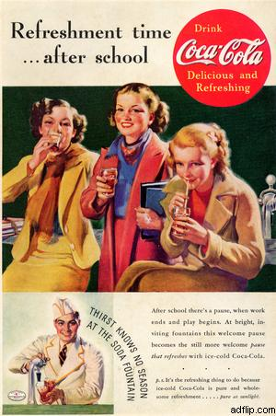
Position
Where is the product placed?
Why is it placed there?

Slide 10
Position
The product is placed in the center of the action.
This product’s placement helps to suggest that it is an important part of having a good time.

Slide 11

Position
Where is the product placed?
Why is it placed there?

Slide 12
Posture
How do the actors carry themselves in the advertisement?
What do their facial expressions and bodily movements suggest about the product being advertised?

Slide 13
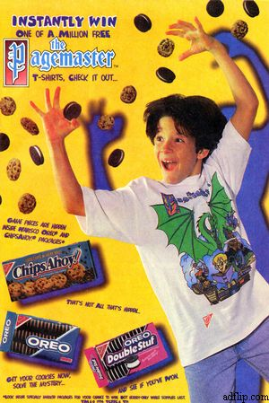
Posture
What is the facial expression and body language of the actor?
What ideas does his expression and body language convey about the product?

Slide 14
Posture
The actor has a happy, excited look on his face. His body suggests energetic movement.
The expression and movement work together to show that this product is fun and exciting.

Slide 15
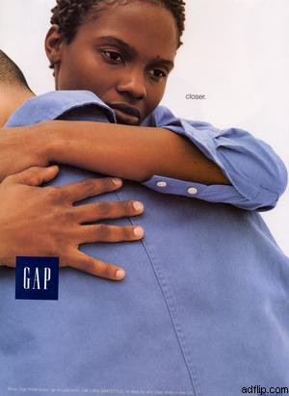
Posture
What is the facial expression and body language of the actors?
What ideas does the expression and body language convey about the product?

Slide 16
Person Speaking
Who is speaking in the ad?
Why was the particular speaker chosen?

Slide 17
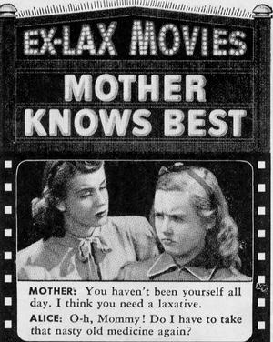
Person Speaking
Who is speaking in the following ad?
Why was this person chosen?

Slide 18
Person Speaking
Here a fictional mother is speaking to her daughter.
People tend to trust advice from their mothers, so a mother is used to add credibility to the product.

Slide 19
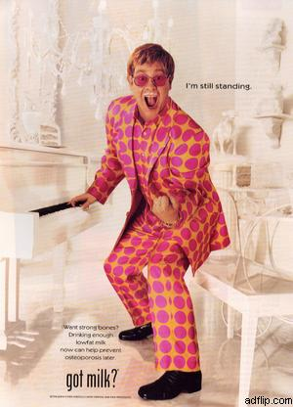
Person Speaking
Who is speaking in the following ad?
Why was this person chosen?

Slide 20
Is that all?
One can certainly can find more things to analyze, such as the wording, music, and motion, when trying to figure out the meaning behind an advertisement. This activity was simply a starting point.
Use what you learned to analyze two of the four ads on the next slide.

Slide 21
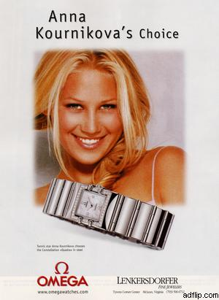
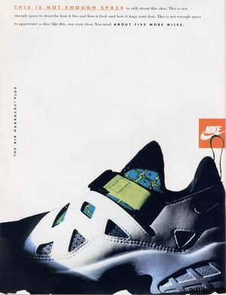
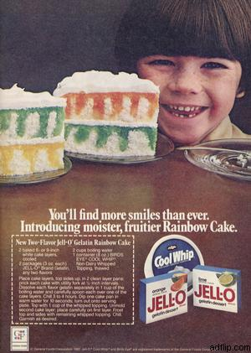

Analyze two of the following ads
1
2
3
4
Click on the ad to see a larger view.

Slide 22
Ad number one

Slide 23
Ad number two

Slide 24
Ad number three

Slide 25
Ad number four

